Slide 1
Presentation on Android

Slide 2
Content
Introduction
Features of Android
Android IDEs
Anatomy of Android Application
Activity Life Cycle
Application Components
UI Components & Layouts
Toast & alert box
Adapter
JSON
Android – SQLite Database
Project

Slide 3
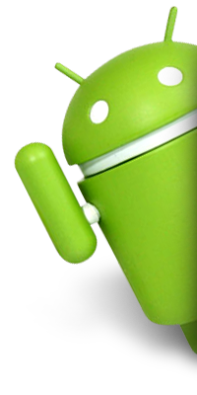
Introduction of Android
Android is Linux based operating system for mobile devices.
Android specially developed for mobile applications.
There are more than 4,00,000 apps in Android market.
The first beta version was released by Google in 2007 where as the first commercial version, Android 1.0, was released in September 2008.

Slide 4

Features of Android
Beautiful UI
Connectivity
Storage
Media Support
Messaging
Resizable widgets

Slide 5
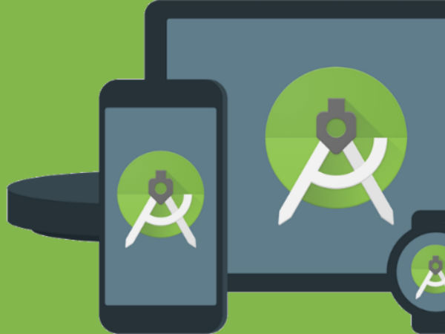
Android IDEs
There are so many sophisticated Technologies are available to develop android applications, the familiar technologies, which are predominantly using tools as follows
Android Studio
Eclipse IDE

Slide 6
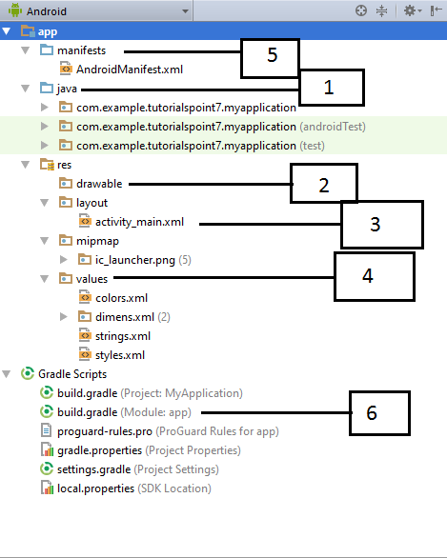
Anatomy of Android Application

Slide 7
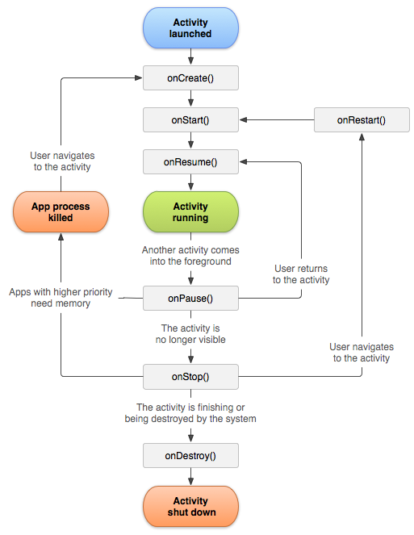
Activity LifeCycle

Slide 8

Application Components
Activities
Layouts
Views
Intents
Manifest

Slide 9
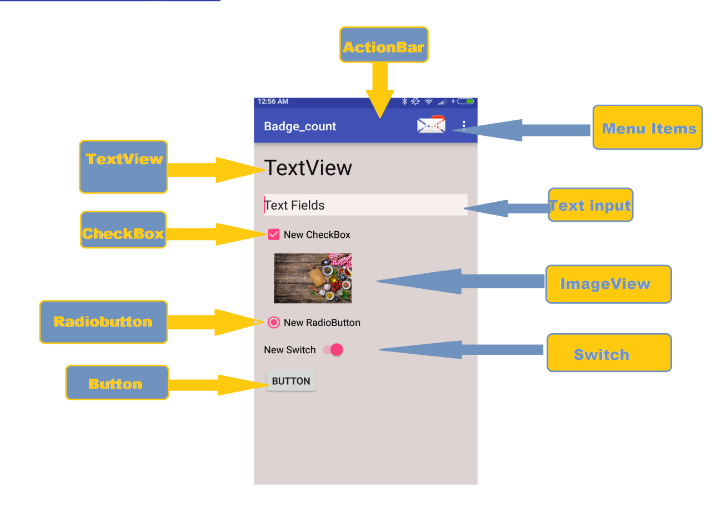
Android UI component

Slide 10
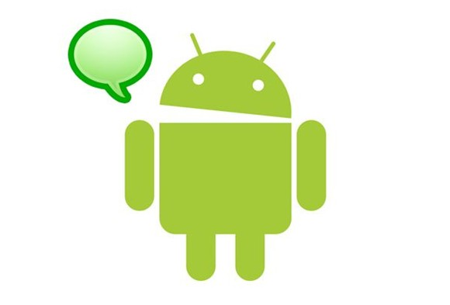
UI Layouts
There are number of Layouts provided by Android which you will use in almost all the Android applications to provide different view, look and feel. But,most commonly are :
Relative Layouts
Linear Layouts

Slide 11
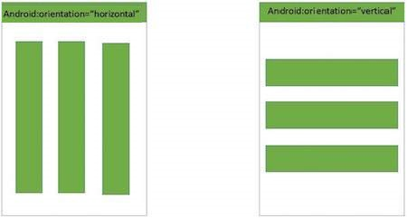
Android Linear Layout
Android Linear Layout is a view group that aligns all children in either vertically or horizontally.

Slide 12
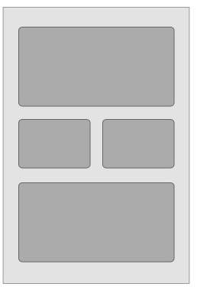
Android Relative Layout
Android Relative Layout enables you to specify how child views are positioned relative to each other. The position of each view can be specified as relative to sibling elements or relative to the parent.

Slide 13
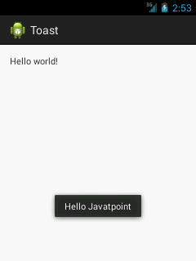
Toast Message
Andorid Toast can be used to display information for the short period of time. A toast contains message to be displayed quickly and disappears after sometime
For Example:
Toast.makeText(getApplicationContext(),"Hello Javatpoint",Toast.LENGTH_SHORT).show();

Slide 14
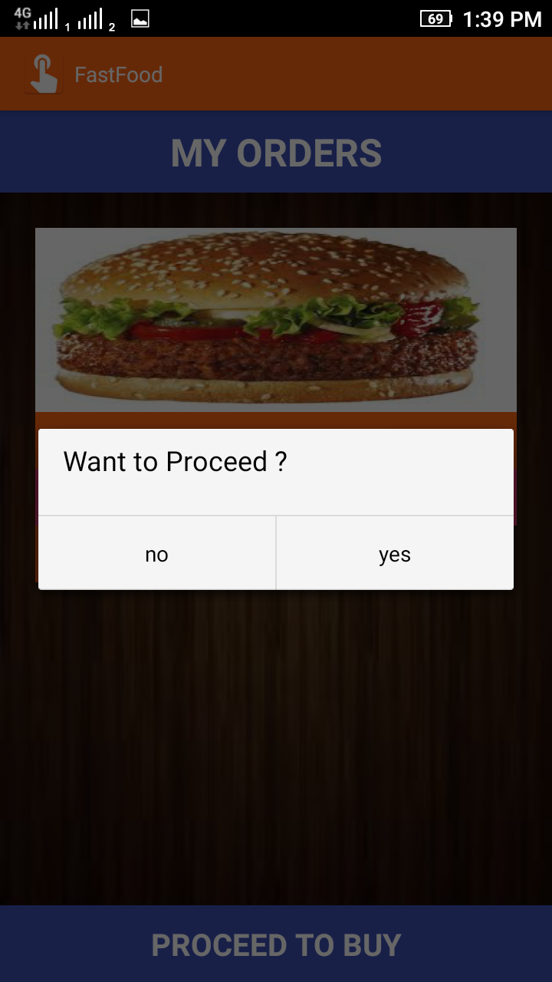
Alert Box
A Dialog is small window that prompts the user to a decision or enter additional information.

Slide 15
Alert Box Example
AlertDialog.Builder builder = new AlertDialog.Builder(context);
builder.setMessage("Want to Proceed ?"); builder.setCancelable(false);
builder.setPositiveButton( "yes", new DialogInterface.OnClickListener() { @Override public void onClick(DialogInterface dialog, int which) {
//proceeding code here
} });
builder.setNegativeButton( "no", new DialogInterface.OnClickListener() { @Override public void onClick(DialogInterface dialog, int which) { dialog.cancel(); } }); AlertDialog alert = builder.create(); alert.show();

Slide 16
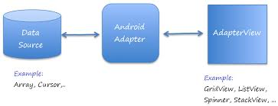
Adapter
In android, an adapter is a bridge between UI component and data source that helps us to fill data in the UI component. It holds the data and send the data to adapter view then view can takes the data from the adapter view and shows the data on different views like as list view, grid view, spinner etc.
ArrayAdapter
BaseAdapter

Slide 17
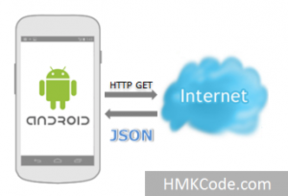
JSON
JSON (Javascript Object Notation) is a programming language . It is minimal, textual, and a subset of JavaScript. It is an alternative to XML.
Android provides support to parse the JSON object and array. It is used to transmit data between a server and web application.
Advantage of JSON over XML
1) JSON is faster and easier than xml for AJAX applications.
2) Unlike XML, it is shorter and quicker to read and write.
3) It uses array.

Slide 18
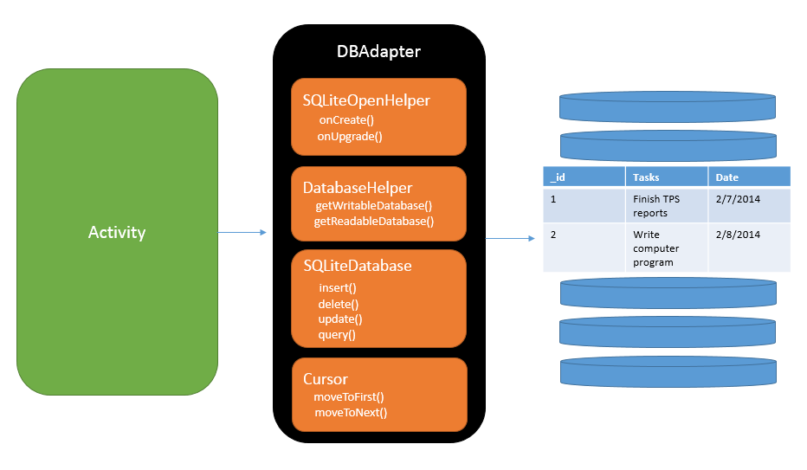
Android - SQLite Database
SQLite is a opensource SQL database that stores data to a text file on a device. Android comes in with built in SQLite database implementation.
SQLite supports all the relational database features.

Slide 19
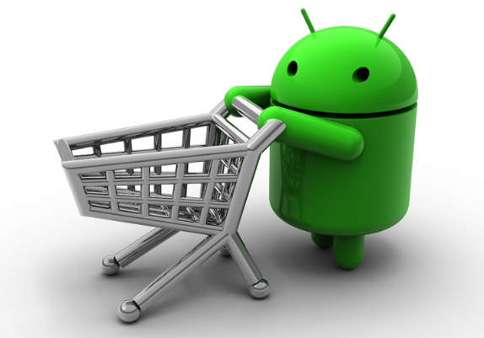
Project
Home Delivery – Food Order

Slide 20
Database Table Used
food
order_history
_id | Integer primary key
s_id | integer
items | string
price | integer
quantity | integer
variant | string
image | string
_id | Integer Primary key
username | string
date | string
address | string
city | string
feed
_id | Integer primary key
username | string
comment | string
email | string

Slide 21
Flow Chart

Slide 22

Fast Food

Slide 23
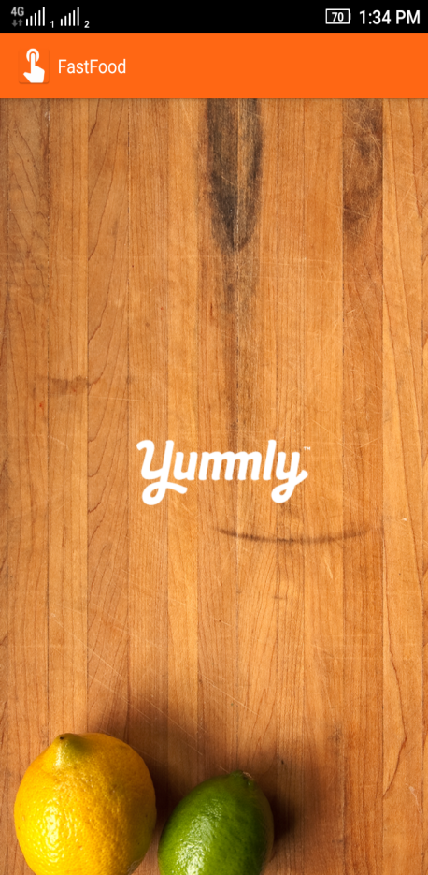
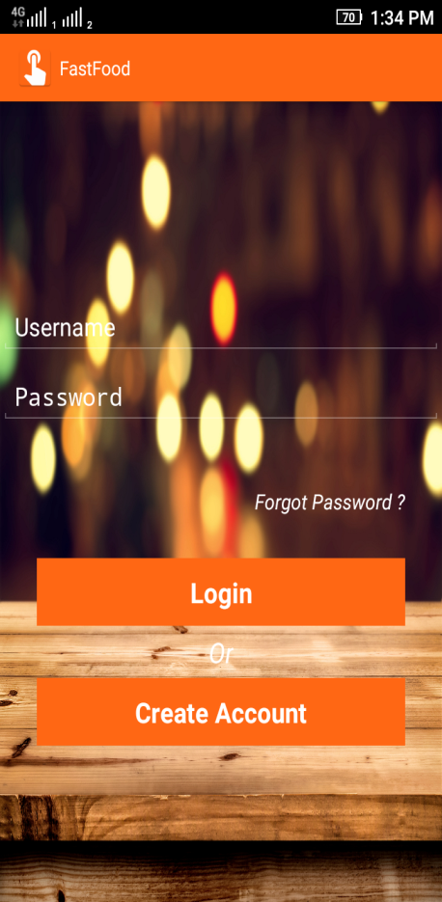
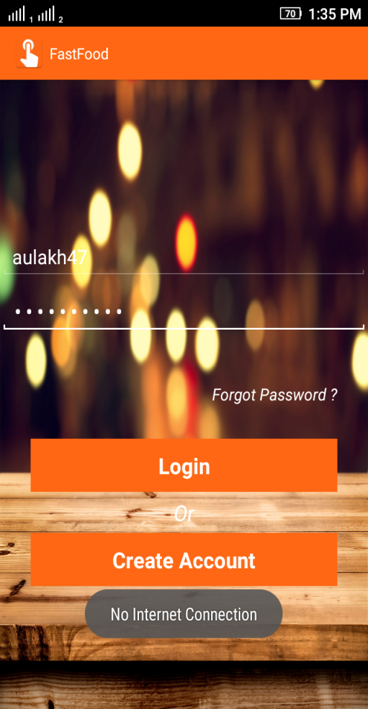
Splash Screen to Login
No Internet Connection

Slide 24

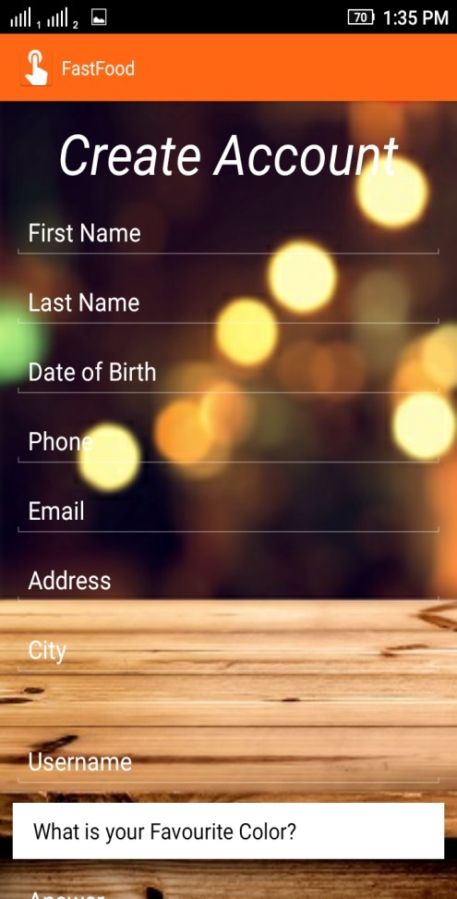
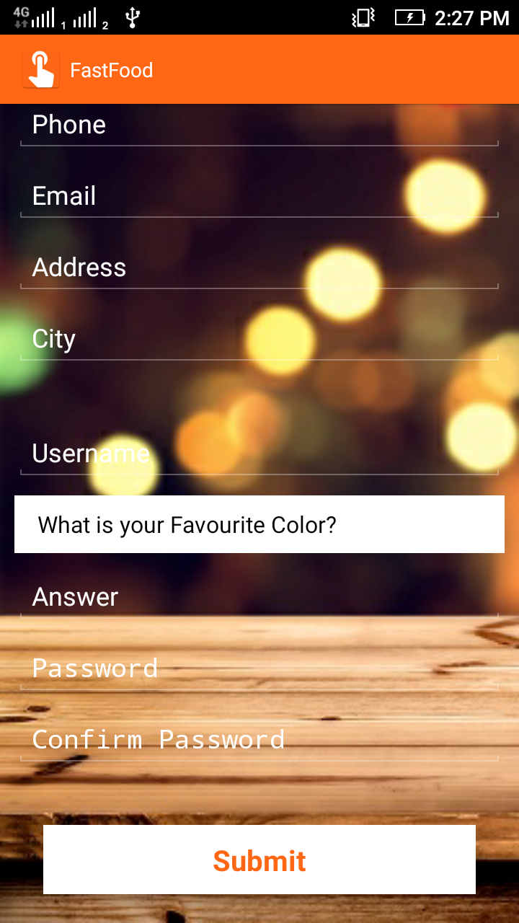
Create Account
Create Account Button
Submit button to register

Slide 25
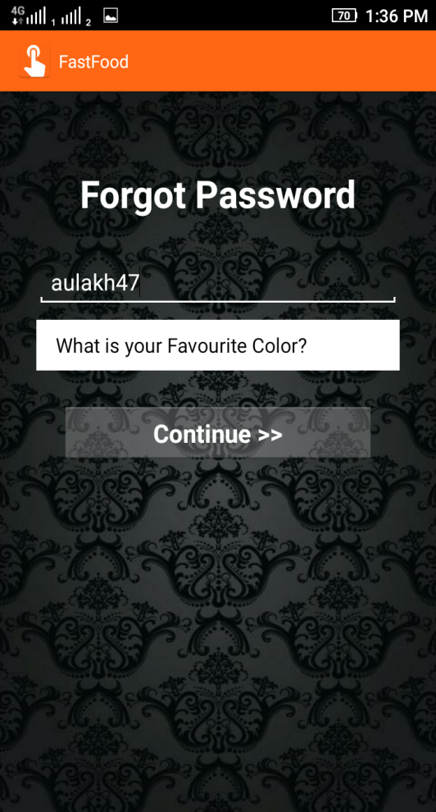
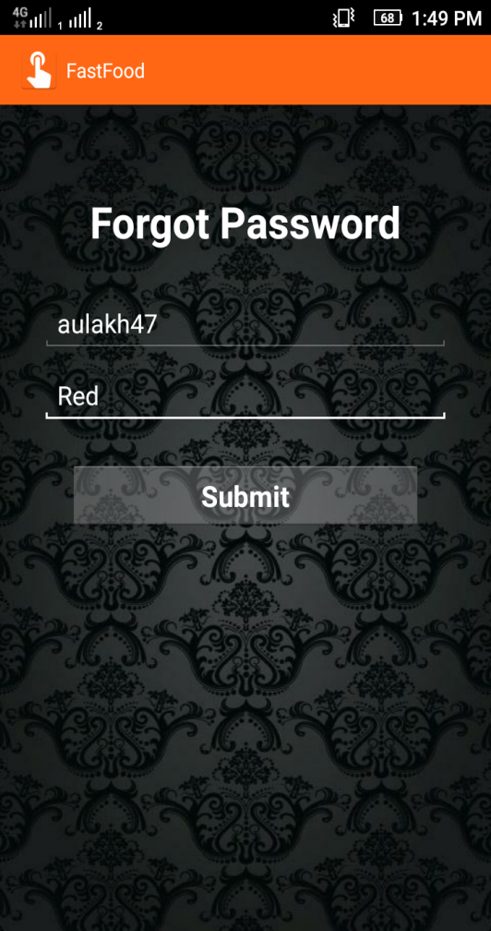
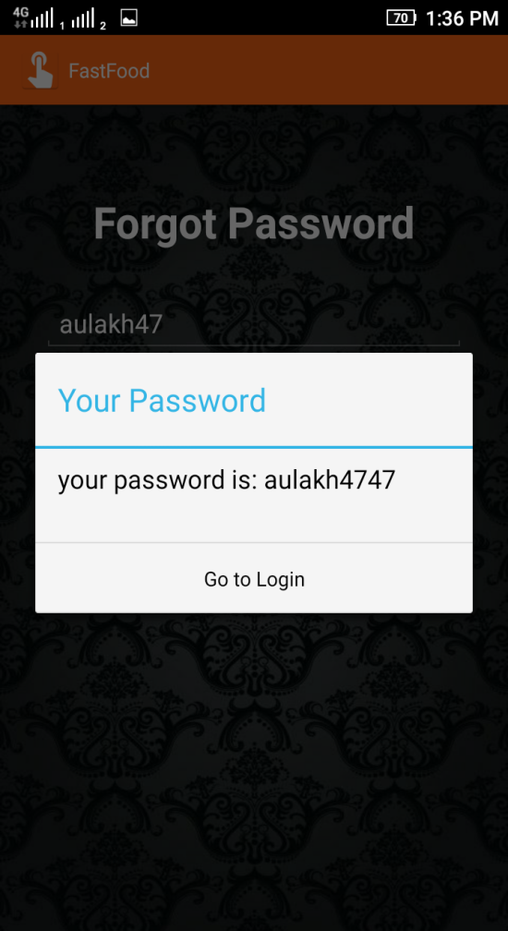
Forgot Password
Password that is User register While Sign Up

Slide 26
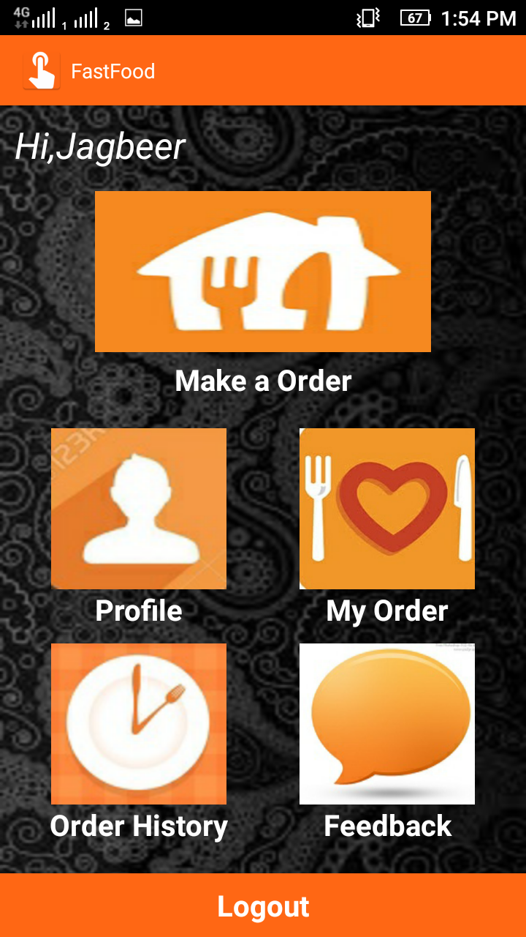
Home Page
User Make a his Order here
User’s Profile
Selected Order is Proceed to buy
Check Order Histroy here
User feedback about app & services
Back to Login

Slide 27
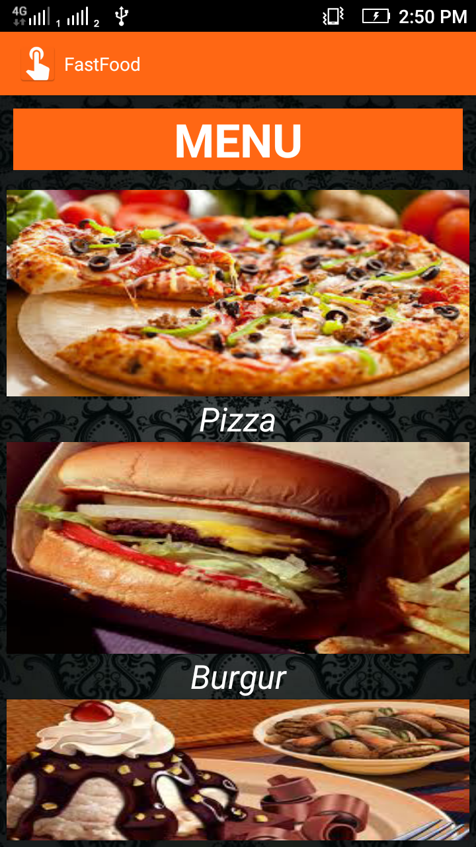
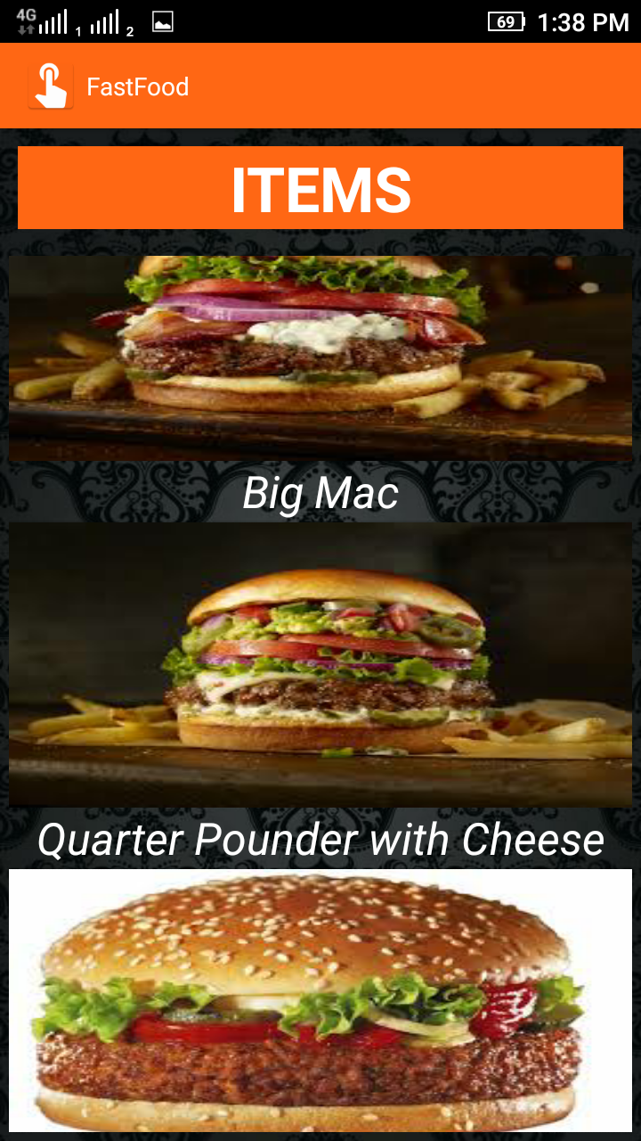
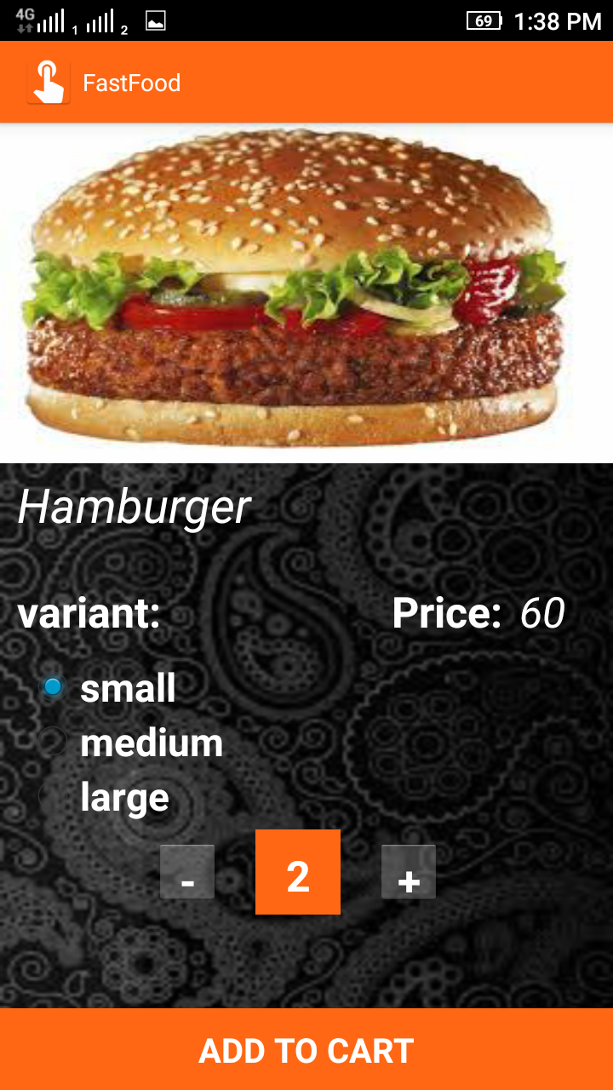
Make a Order

Slide 28
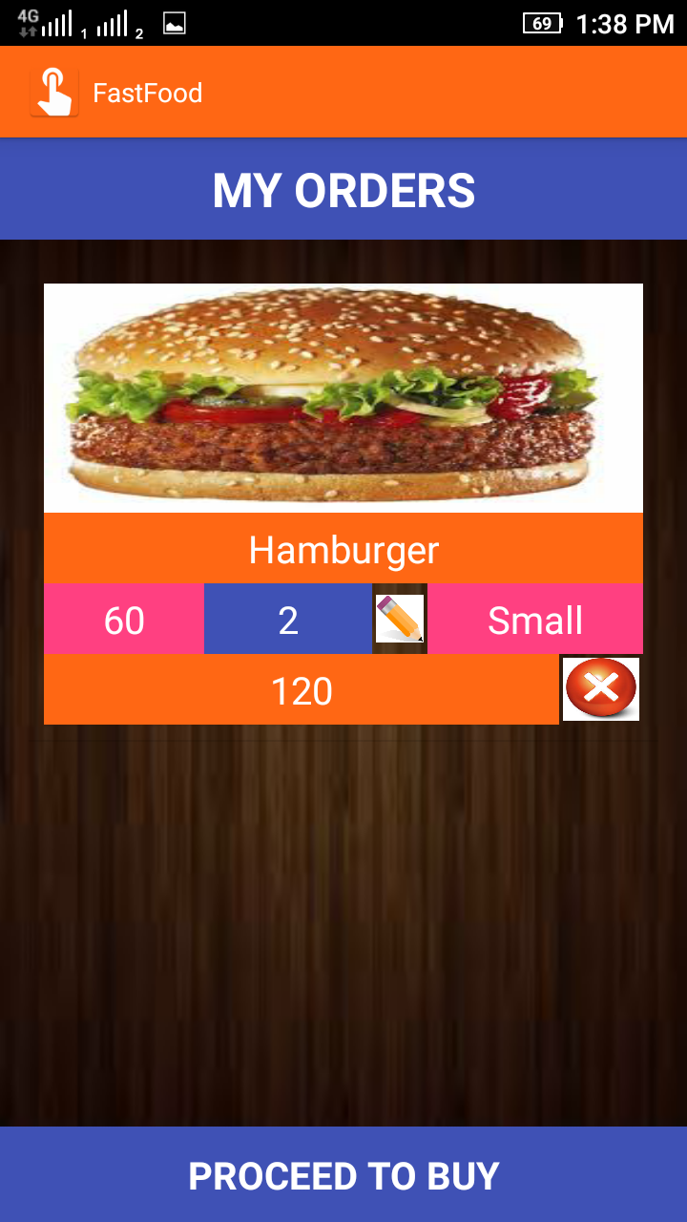
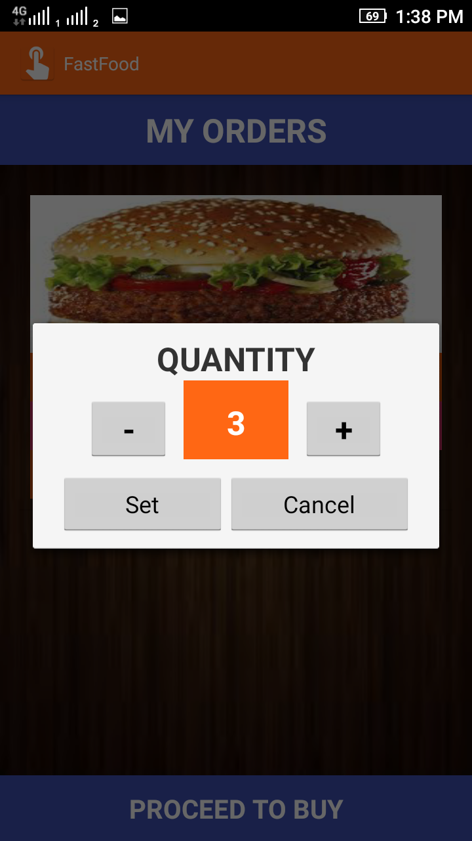
Proceed to Buy
Total Price
User change quantity here
Proceed to buy

Slide 29
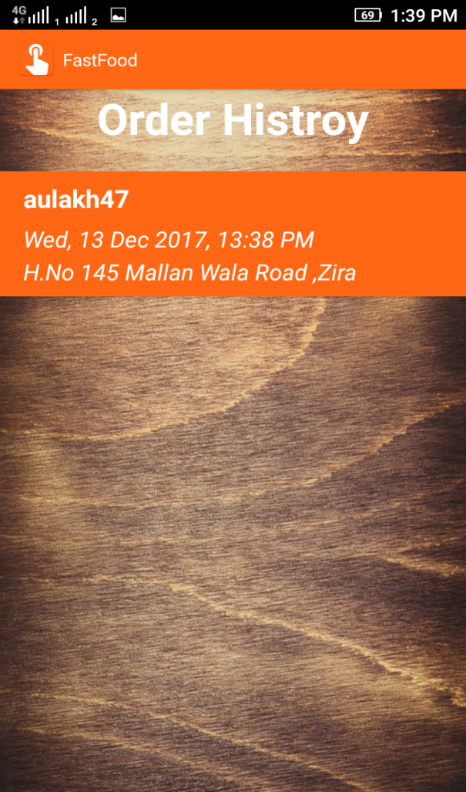
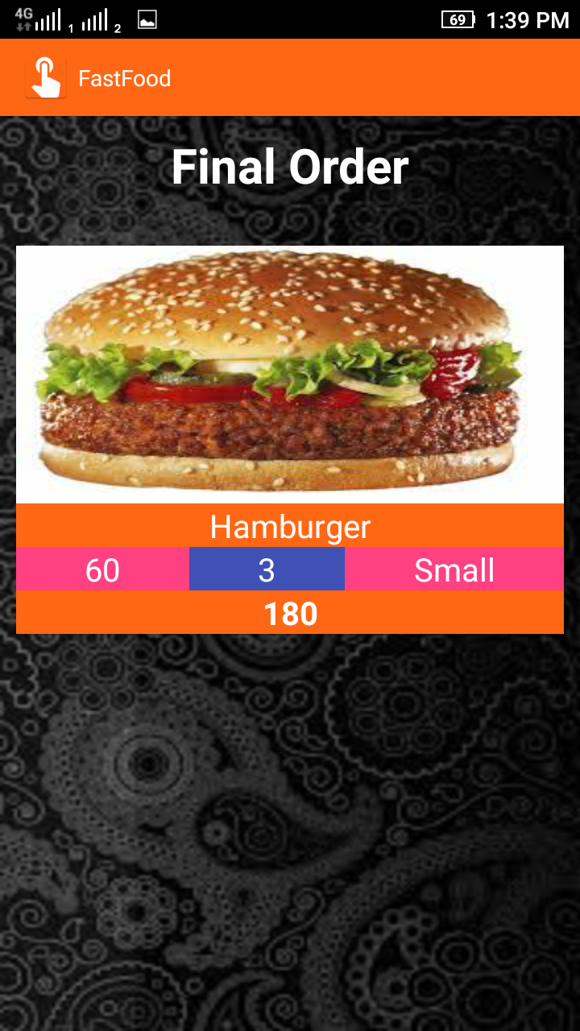
Order Histroy

Slide 30
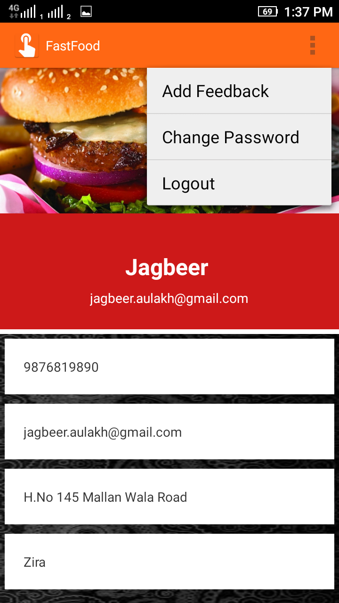
User Profile
Add feedback here
Change Password here
Back to Login

Slide 31
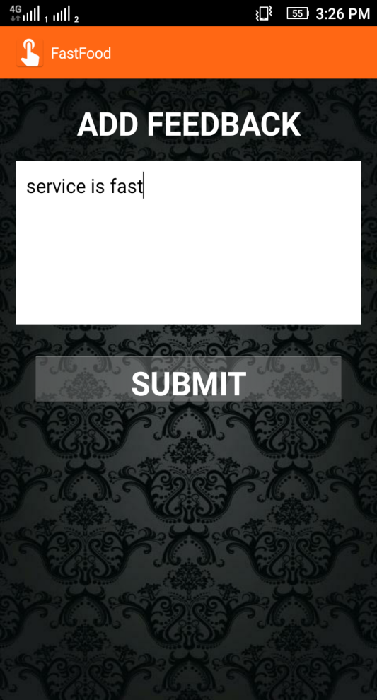
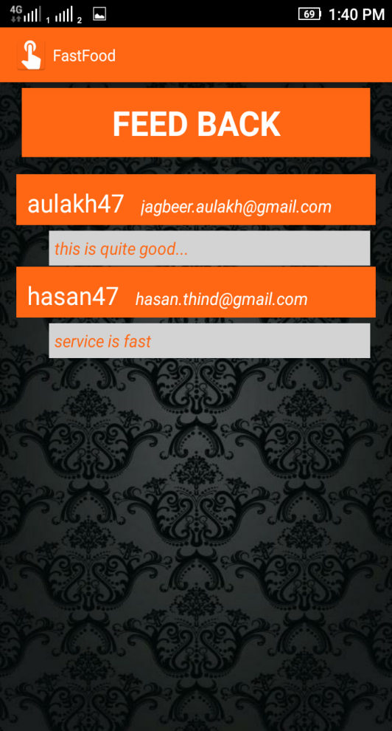
FeedBack
Feedback shown here
Add Feedback here

Slide 32
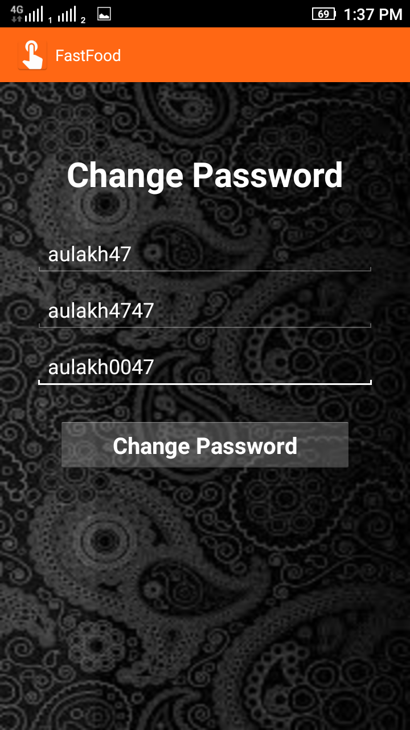
Change Password
Username
User’s old password
Set new password

Slide 33
Thank You

